Slide 1
GALE LITERATURE RESOURCE CENTER
Notes:
Use this slide to introduce yourself and the presentation.
Notes throughout this presentation provide instruction around areas to customize for your specific audience, as well as speaker notes to make the process of presenting easier. Feel free to hide slides and select what content to feature if you are given shorter speaking times, or if you’re able to take attendees live into Gale Literature Resource Center.

Slide 2
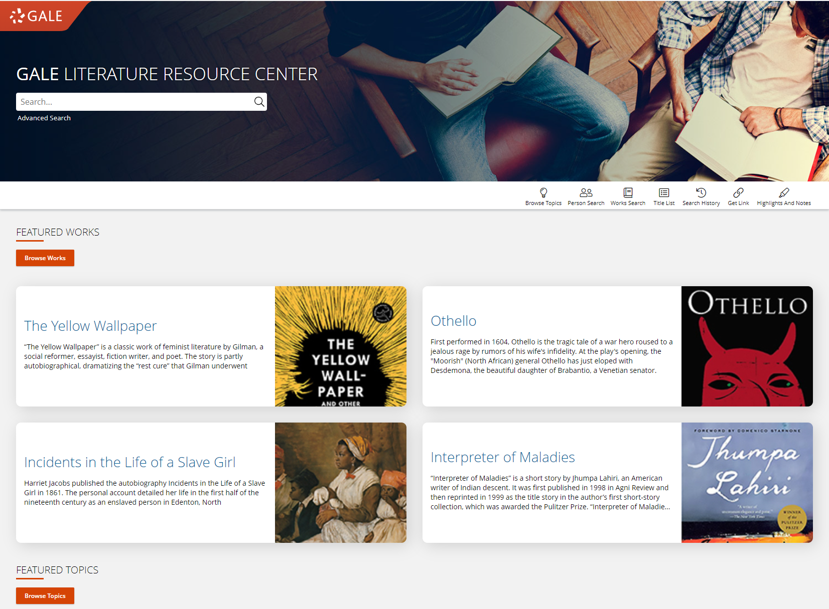
GALE LITERATURE RESOURCE CENTER
Broaden Perspectives
With 700+ portal pages, Literature Resource Center provides a mix of the most-studied works from a diverse range of authors.
Easy Navigation
Users can browse by popular works and curated topics pages that will guide them to other related topics & continue the research process.
Access Full Text Works
Literature Resource Center is loaded with over 100 full text works users can simultaneously access and annotate.
Notes:
Gale Literature Resource Center is Gale’s most current, comprehensive, and reliable online literature resource, offering the broadest and most representative range of authors and their works, including a deep collection of full-text critical and literary analysis for literary studies. The resource provides researchers with unbounding literary resources to support their literary responses, literary analysis, and thesis statements through a diversity of scholars and critics that ensure all views and interpretations are represented.

Slide 3
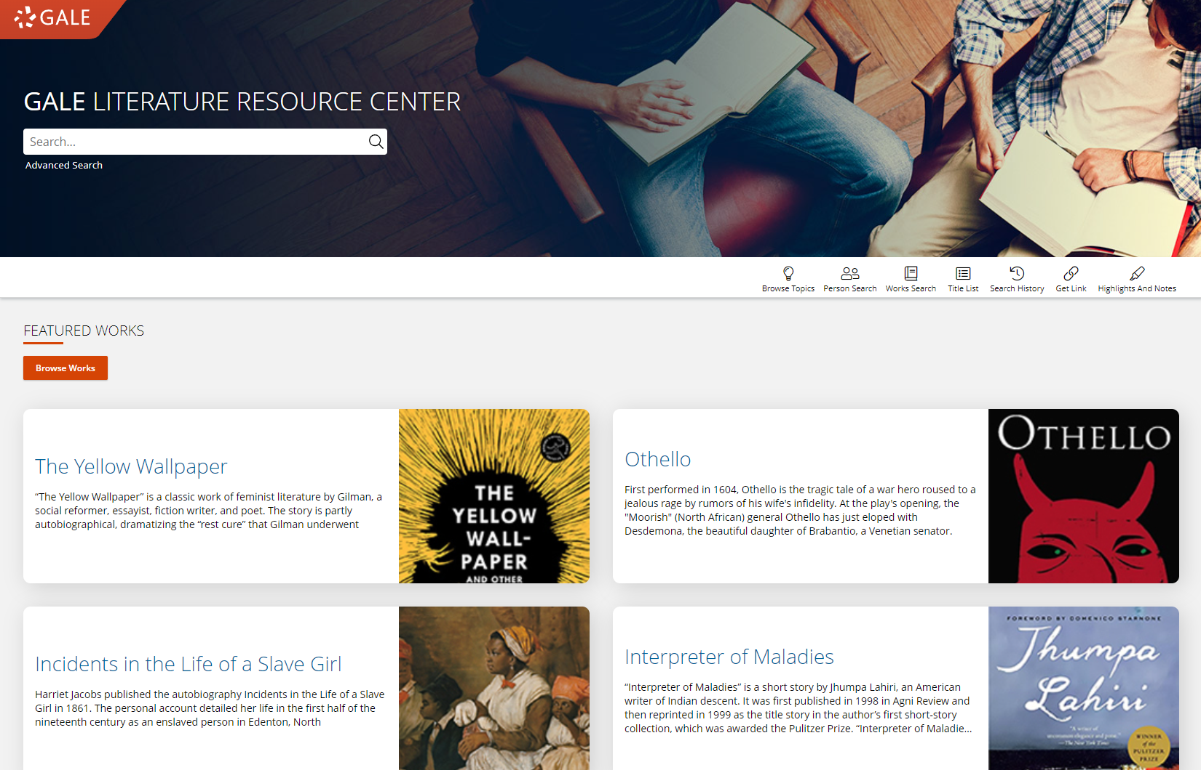
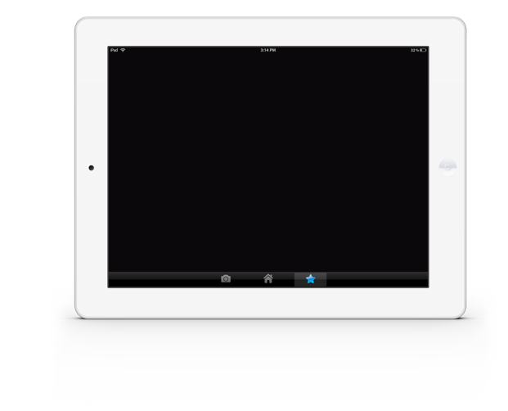
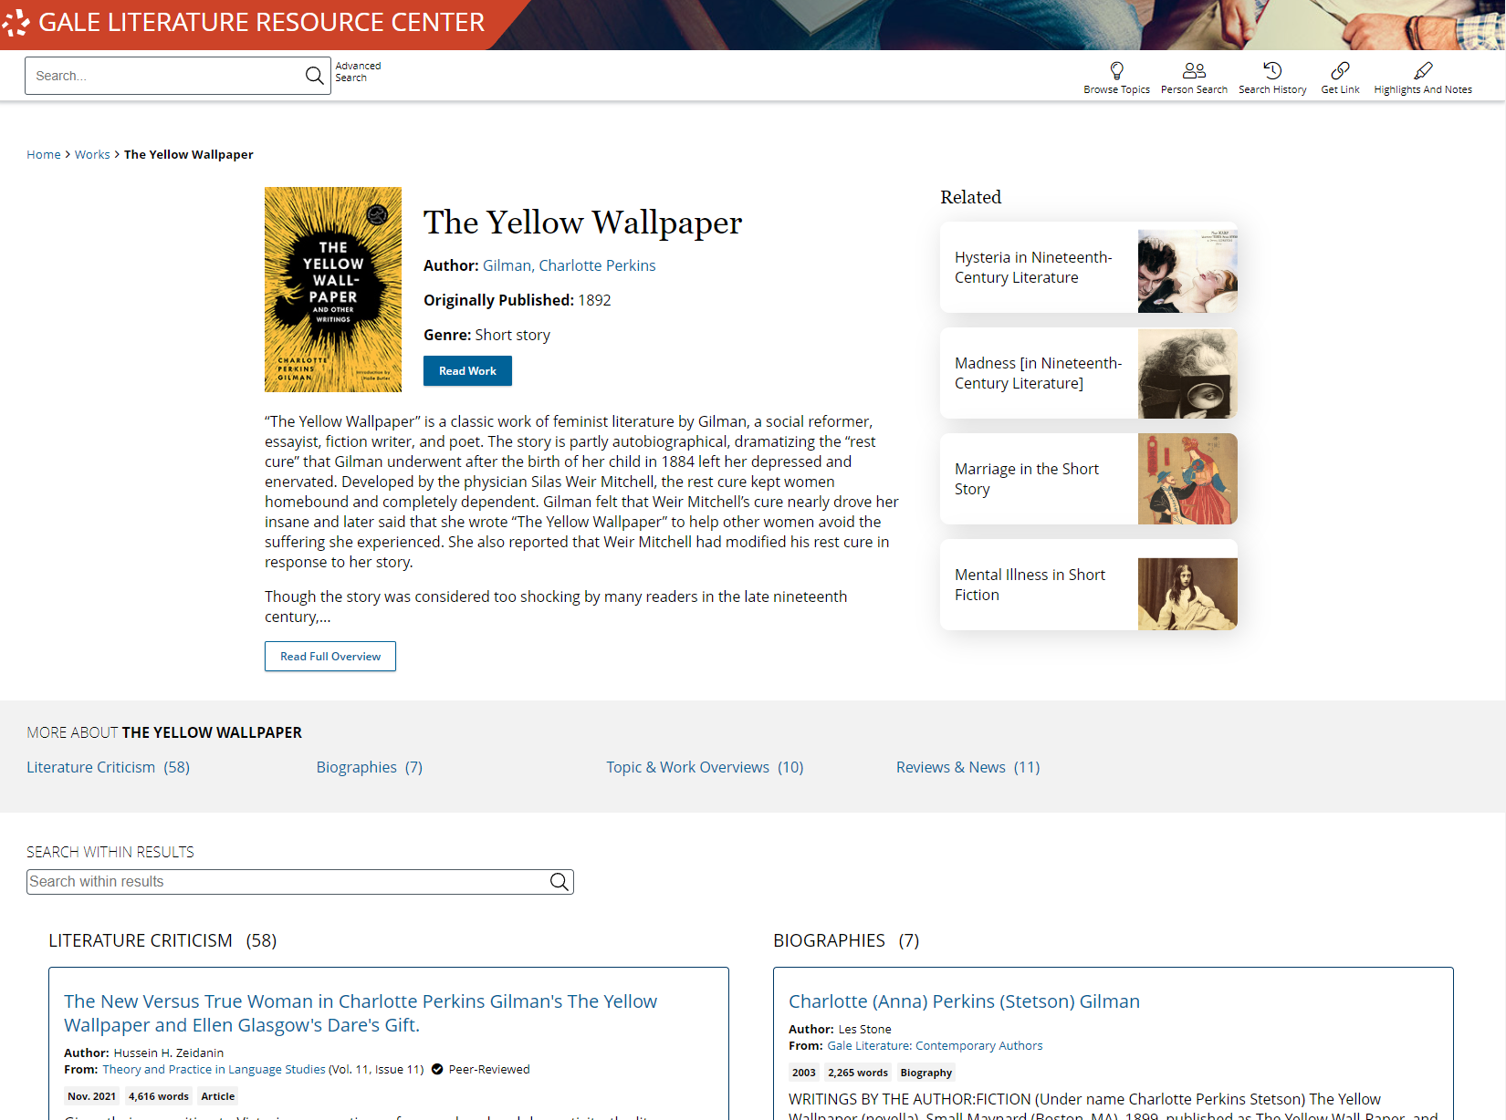
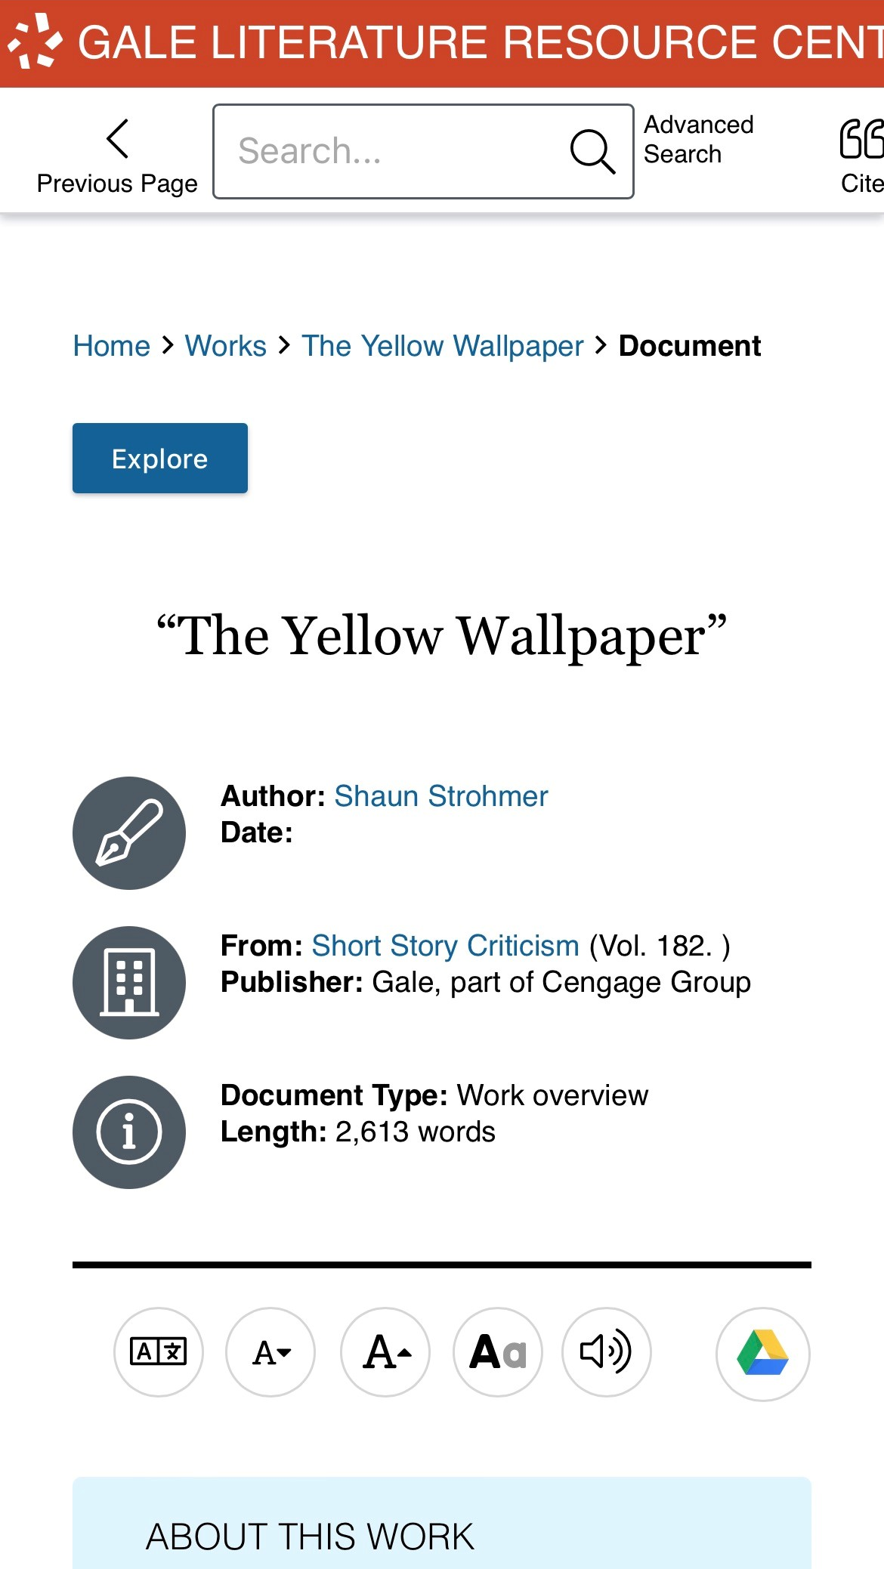
SIMPLE ACCESS
Anytime
Anywhere
Any Device
Without Ads or Paywalls
Notes:
All of the content in Gale Literature Resource Center can be accessed by you and your patrons 24/7 on any device, no matter where you are. Additionally, Gale Literature Resource Center is an ad-free environment that provides full-text access without paywalls.

Slide 4
DISCOVER PREMIUM RESOURCES

Slide 5
SEARCH OR BROWSE
EXPLORE CONTENT
VIEW AND SHARE
Notes:
It’s easy to access all the premium resources within Gale Literature Resource Center by browsing or searching for topics of interest, exploring content organized by type, and then clicking individual result titles to view and use recommended resources, journals, videos, images, literary criticisms, and more.

Slide 6
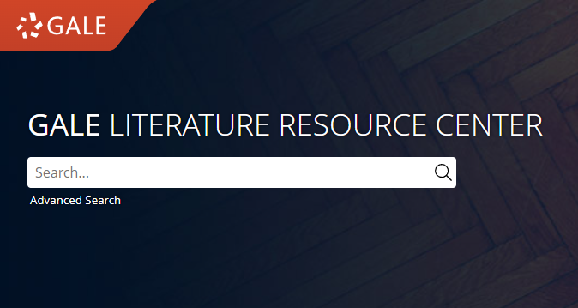
SEARCH
Enter simple search terms
Notes:
To perform a basic search, just enter key terms related to topics of interest in the search box on the homepage or at the top of every page throughout Gale Literature Resource Center.

Slide 7
SEARCH
Enter simple search terms
Or, customize multiple fields and limiters
Notes:
You can also run a more targeted or customized search by clicking the Advanced Search option beneath or to the side of the basic search box. Advanced Search provides the option to select specific search fields (For example, publication title if you’re looking for articles in a specific journal) and combine these fields/terms in various ways (for instance using NOT if you want articles about one subject but are NOT interested in any articles that also focus on a related subject that is not relevant to what you are researching). If you scroll down the page, you can also include search options to limit results by document type, date, and more.

Slide 8
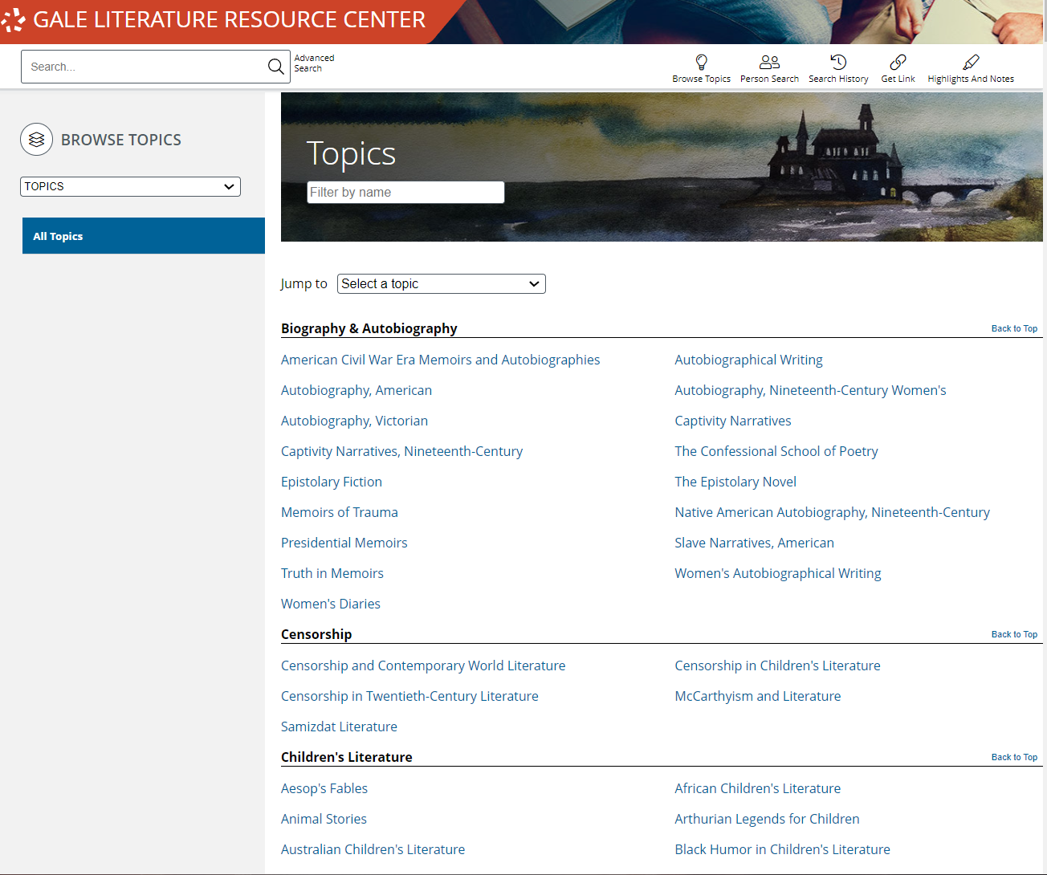
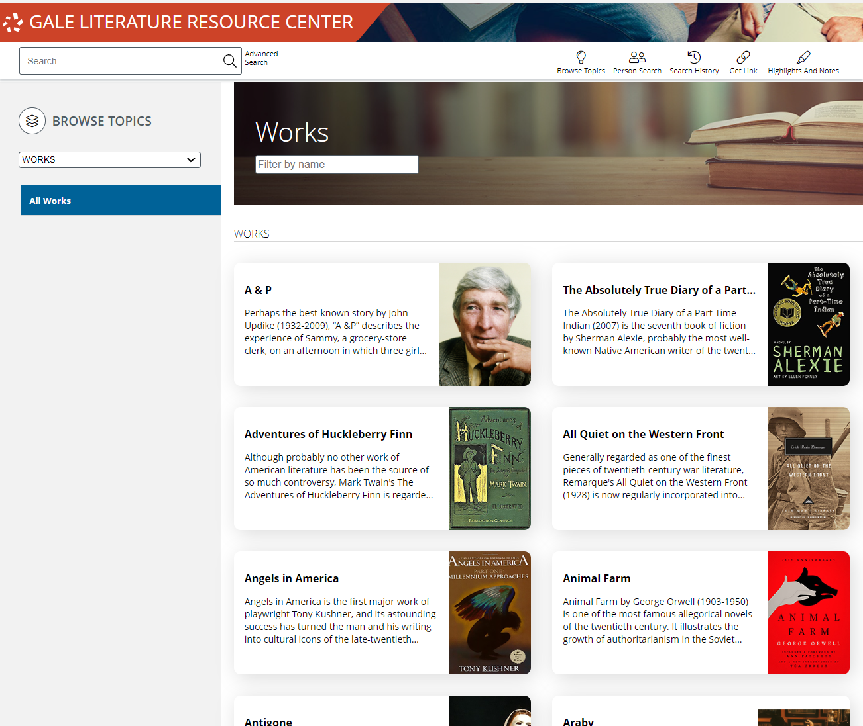
BROWSE
Browse topics
Or, browse works
Notes:
In addition to searching, Gale Literature Resource Center is designed to make it easy for your patrons to browse for topics of interest. Simply click the Browse Topics option in the upper right corner of the homepage and on many other pages throughout the resource to access a list of all topics for which there are curated pages. If desired, you can use the drop-down menu at the top of this page to view pages based on categories of interest.
When you click the title of one of the topics, you’ll be taken to a results list focused on your topic. Simply click the header for a content type to view all results of that format, and click the title of an individual result to view that specific piece of content.
Note that if you do not see a topic related to something of interest, that just means that you will need to run a basic or advanced search within Gale Literature Resource Center to view any available results (it doesn’t mean content on that topic is unavailable).

Slide 9
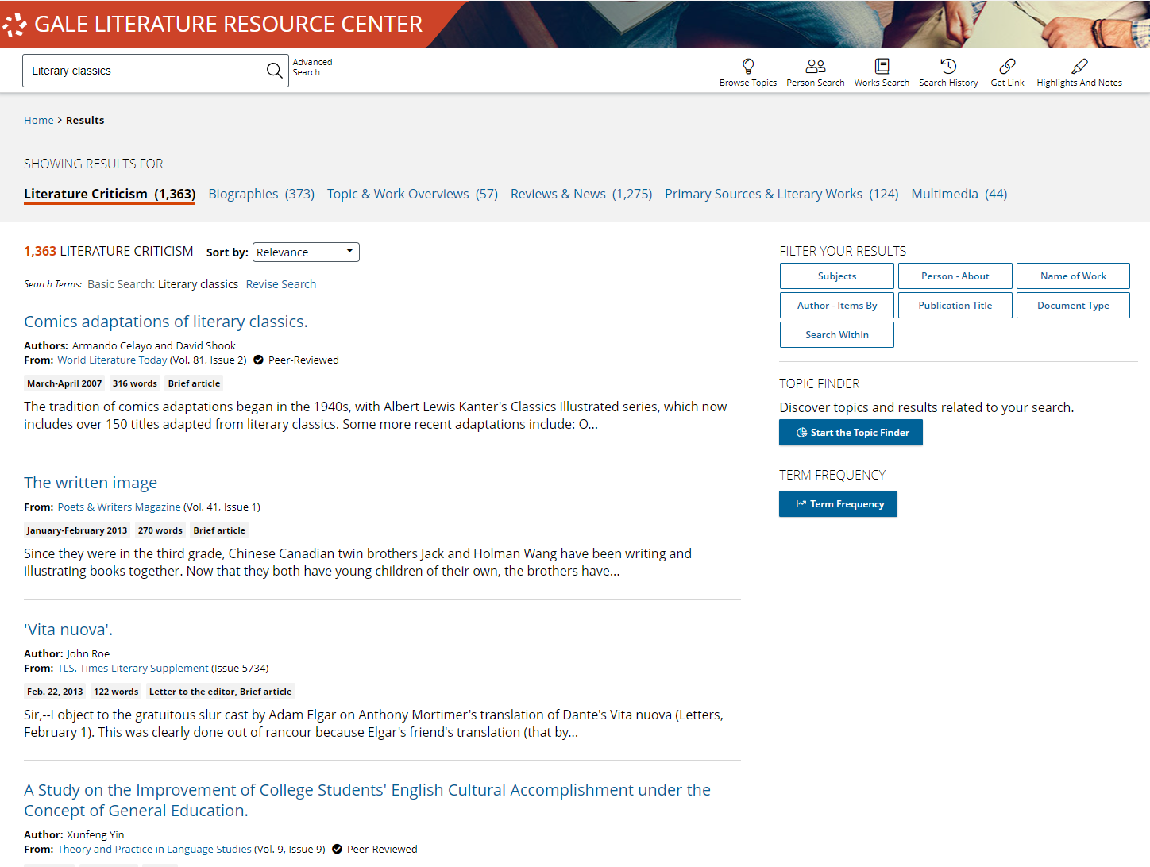
EXPLORE AND FILTER RESULTS
EXAMINE CONTENT TYPES
Select a Content Type to focus on results within that format
Notes:
Once you run a search you’ll find options to further pinpoint results of interest. At the top of the page, you can click to view results of specific types (Literature Criticisms, Biographies, Topic and Work Overviews, etc.) depending on what’s available for your search.

Slide 10
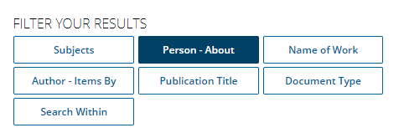
EXPLORE AND FILTER RESULTS
EXAMINE CONTENT TYPES
Select a Content Type to focus on results within that format
NARROW RESULTS
Limit by publication title, subjects, peer-reviewed journals, etc.
Notes:
In the Filter Your Results portion on the right-hand side of the results, you’ll find options to limit your search results further based on publication date, subjects, document types, etc. Simply click one of the filtering options, check the box next to specific filters of interest, and then click to Apply the filter.
Note that these are also great options to point out to patrons who are running very broad searches.

Slide 11
EXPLORE AND FILTER RESULTS
EXAMINE CONTENT TYPES
Select a Content Type to focus on results within that format
NARROW RESULTS
Limit by publication title, subjects, peer-reviewed journals, etc.
VIEW INDIVIDUAL SOURCES
See document information like date, publication, and word count before selecting it
Notes:
When you find an item that you’d like to view, simply click the title of the result to access the content.

Slide 12
EXPLORE CONTENT
TOPIC AND WORKS OVERVIEWS
MULTIMEDIA MATERIALS
LITERATURE CRITICISM
FULL-TEXT WORKS
BIOGRAPHIES
Notes:
Depending on the topic you search or browse, you will find a wide variety of content types.

Slide 13
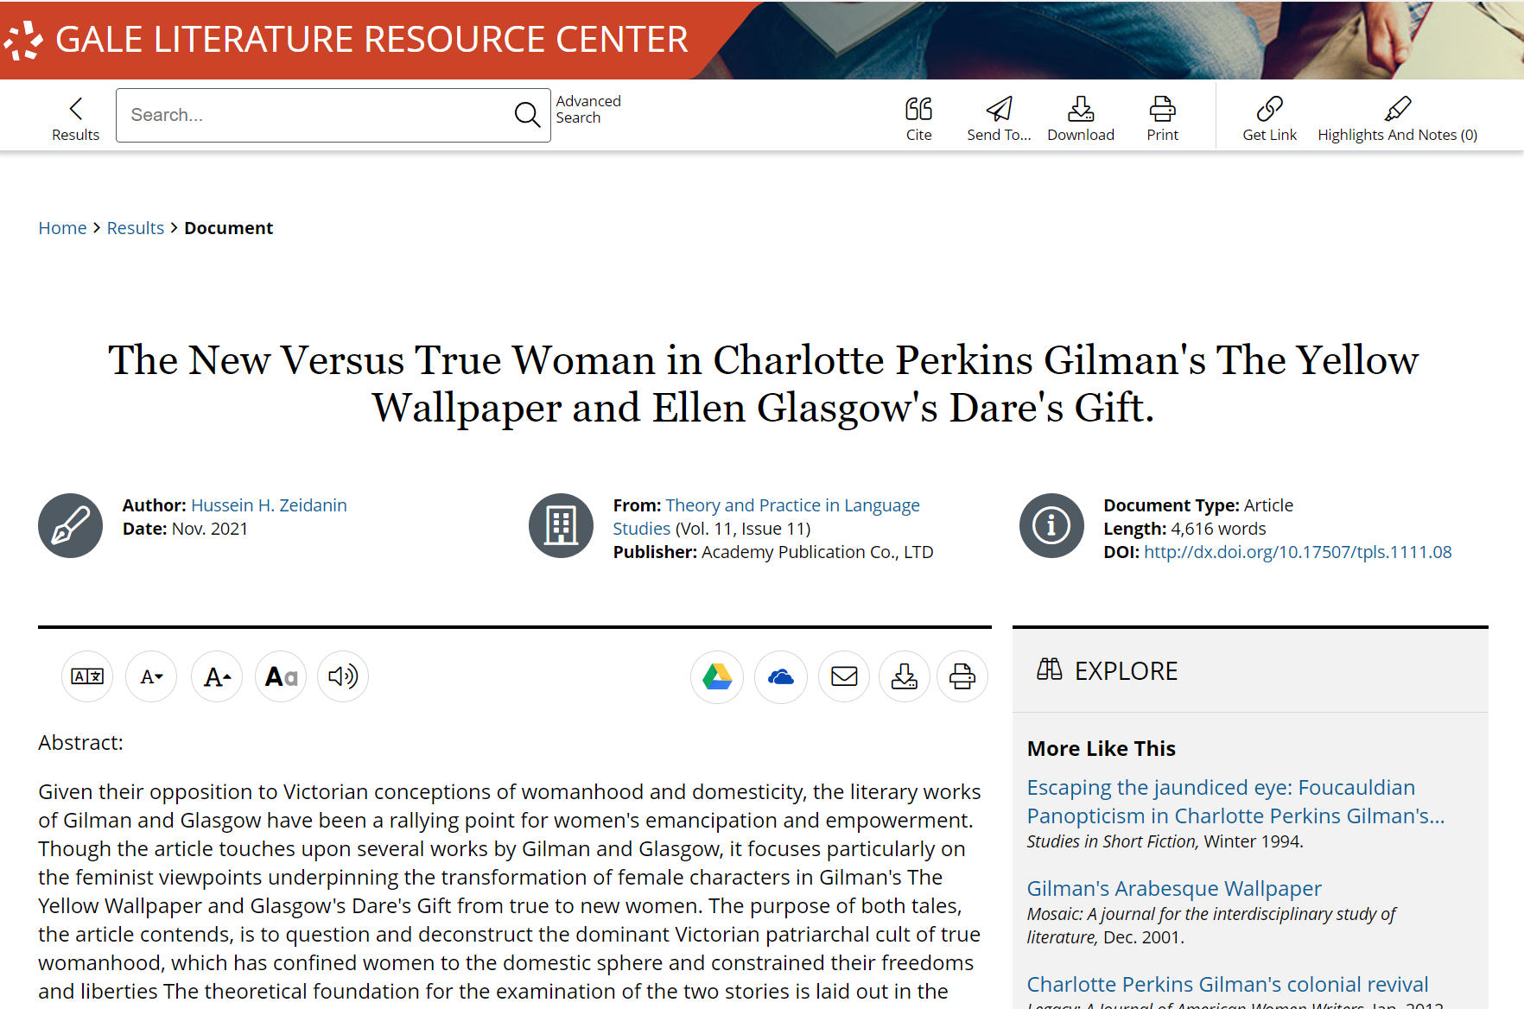
EXPLORE CONTENT: LITERATURE CRITICISM
LITERATURE CRITICISM
Over 85,000 selected full-text critical essays and reviews from Contemporary Literary Criticism, Twentieth-Century Literary Criticism, Nineteenth-Century Literature Criticism, and much more
Notes:
Literary Criticism are analysis and opinions with supporting evidence that related to different aspects of literature, such as theme, style, setting, or political context.
Literary Criticisms can broaden the understanding of a work.

Slide 14
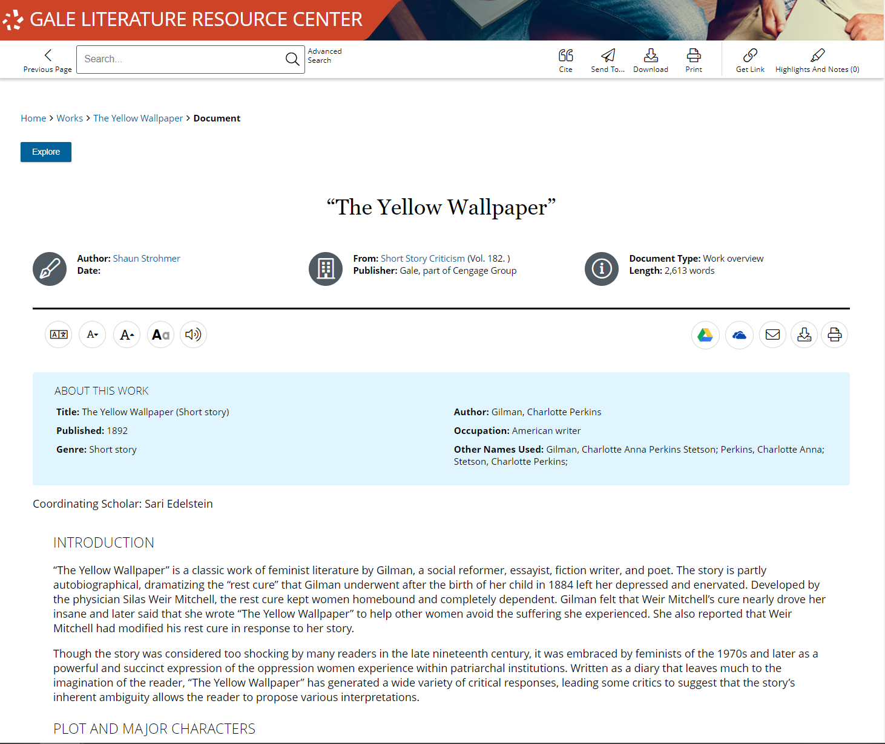
EXPLORE CONTENT: TOPIC AND WORKS OVERVIEW
TOPIC AND WORKS OVERVIEW
Over 17,000 Topic and Works Overviews included from The Journal of Literary Studies, The Journal of Narrative Theory, Merriam Webster’s Encyclopedia of Literature, and more
Notes:
Topic and Works Overviews give a general reference covering either the topic or work of interest.
A Publication Search found within our Advanced Search can allow patrons to limit to a specific periodical of interest, or they can use the Publication Title filter in their search results.

Slide 15
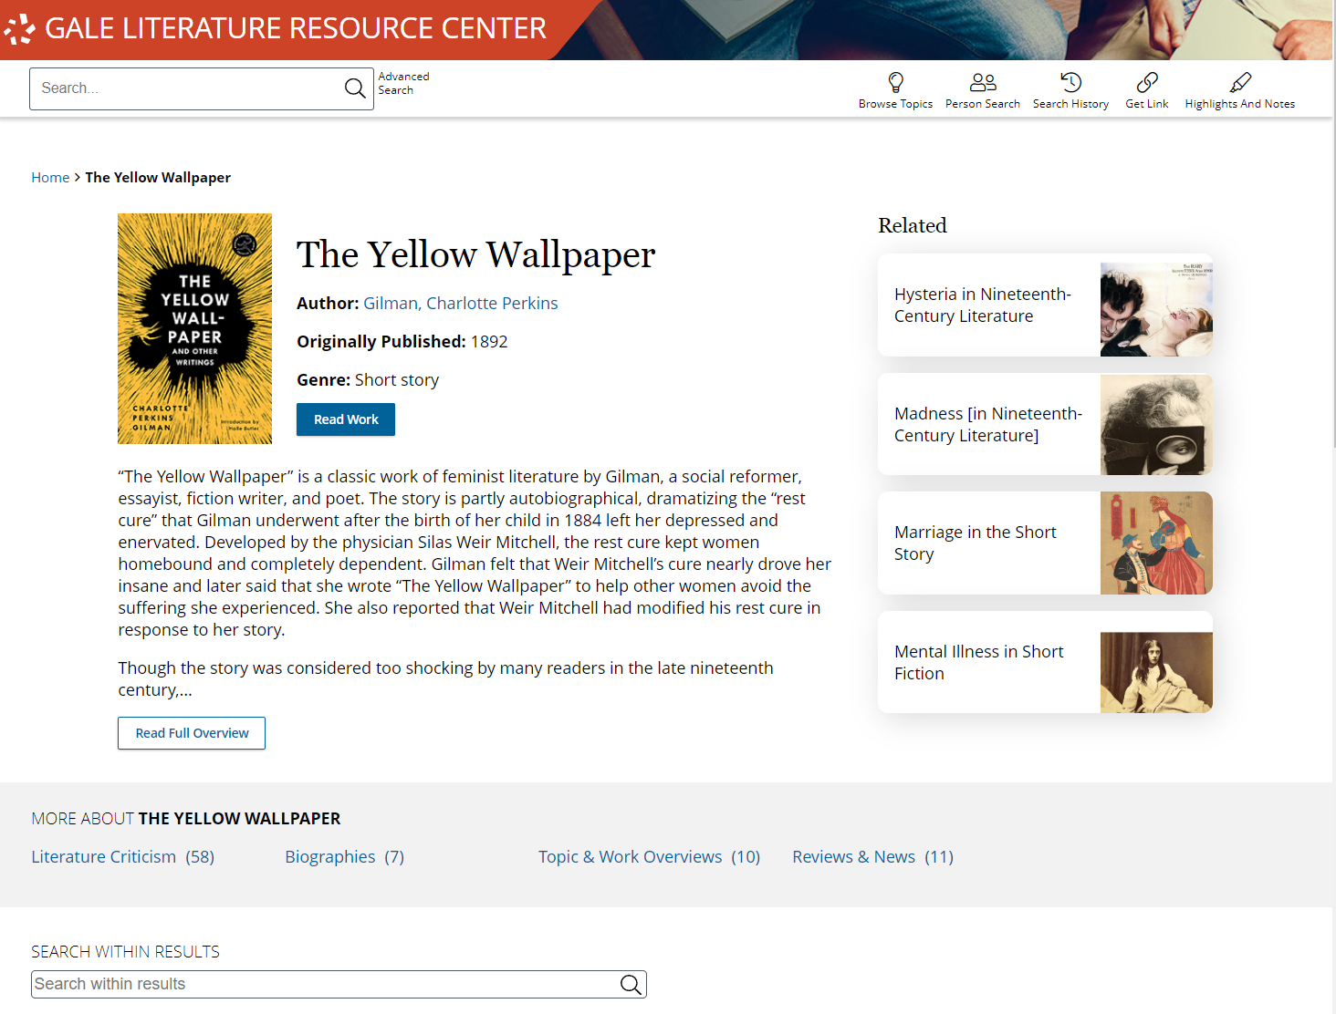
EXPLORE CONTENT: FULL-TEXT WORKS
FULL-TEXT WORKS
Over 100 Full-Text Works are found in Gale Literature Reference Center.
On Work Pages click Read Work to be taken to the Full Literary Work
Notes:
Direct your Patron to Full Literary Works that require no check in or check out Process. These can be read simultaneously, linked directly, and include our accessibility tools, such as translate, text to speech, and display manipulation.

Slide 16
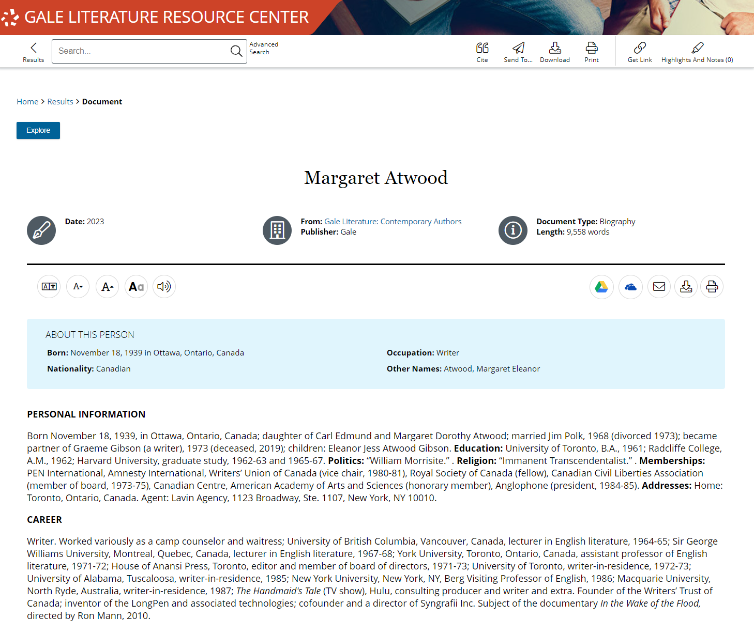
EXPLORE CONTENT: BIOGRAPHIES
BIOGRAPHIES
More than 160,000 complete entries from two award-winning series- Contemporary Authors and Dictionary of Literary Biography- for an in-depth bibliography on author’s live and works..
Notes:
Gale Literary Resource Center provides biographical information for both classic and contemporary figures. Find the content bucket of Biography after a search, a topic page, or under Advanced Search.

Slide 17
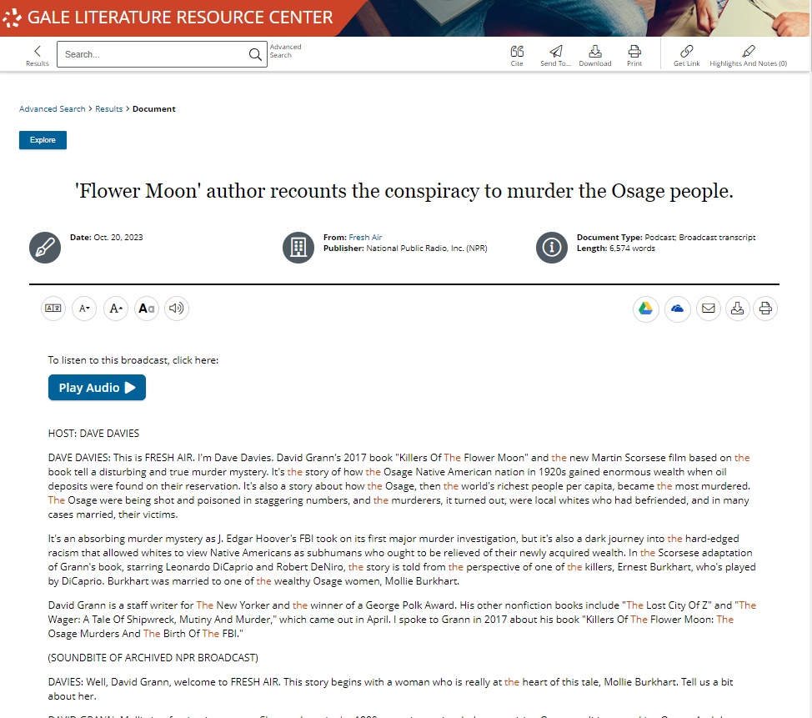
EXPLORE CONTENT: MULTIMEDIA
MULTIMEDIA
Find all kinds of Multimedia content to support all different types of learning and research, including audio files, interviews, tables, podcasts, cartoons, images, photographs, paintings, and more.
Notes:
Multimedia content supports researcher preference to increase accessibility.

Slide 18
ENHANCE RESEARCH

Slide 19
SHARE AND SAVE CONTENT
Get Link, Send To, Download, Print
Collect premium resources to share with colleagues, or save for later
INCREASE ACCESSIBILITY
Translate, Text Manipulation, Listen
Provide options for patrons with varied needs and preferences
SUPPORT LITERARY RESEARCH
Work Pages, Topic Pages, and Highlights and Notes
Allow patrons to organize research and find key points in literary topics and ideas
Notes:
These tools support patrons through all stages of research. Patrons will be able to find and save the content they need, access it in the best possible format for them, and highlight important ideas right in their documents.

Slide 20
SHARE AND SAVE CONTENT
GET LINK
Create a persistent URL to the page you are on
Notes:
Get Link links are persistent- they won’t break over time. These links are great for you to share with patrons through social media, email lists, or business groups. Patrons can also utilize these links to save their content for later or share the content with peers/ colleagues.
When someone selects a link they will be automatically taken to that page within Gale Business: Entrepreneurship. If they decide to navigate through the resource, they will be asked to authenticate in whatever method you have established.

Slide 21
SHARE AND SAVE CONTENT
GET LINK
Create a persistent URL to the page you are on
SEND TO
Send articles to a Google or Microsoft drive, or email
Notes:
Sending materials to Google or Microsoft drive allows your patrons to keep the full text for as long as they want. The content will be sent to whatever drive is signed into on the browser. If a patron hasn’t signed into their account yet, it will prompt them. They can access these tools either in the tool bar at the top of a document page, or in the tool buttons on the right side under the document information.

Slide 22
SHARE AND SAVE CONTENT
GET LINK
Create a persistent URL to the page you are on
SEND TO
Send articles to a Google or Microsoft drive, or email
PRINT AND DOWNLOAD
Print full documents, or download directly to your computer
Notes:
Unlimited printing and downloading allow patrons to access their full text offline.
These buttons are found next to the Send To button in the tool bar and the buttons under the title.

Slide 23
INCREASE ACCESSIBILITY
TRANSLATE
Machine translate both articles and resource navigation
Notes:
Every article includes a simple translation button allowing patrons to choose they language they prefer. Utilizing Set Interface Language will change all the navigation buttons and tools within the platform to the selected language.
To translate an article or the interface select the Translate button found in the set of tools on the left of the screen under the document information.

Slide 24
INCREASE ACCESSIBILITY
TRANSLATE
Machine translate both articles and resource navigation
TEXT MANIPULATION
Edit how article text is viewed by changing the font size, color, style, and spacing
Notes:
Utilizing the text manipulation tools provides for the most customized experience. Patrons can choose their preferences and they will be retained through the duration of their session.
These options are found in the next to the Translate button under the document information.

Slide 25
INCREASE ACCESSIBILITY
TRANSLATE
Machine translate both articles and resource navigation
TEXT MANIPULATION
Edit how article text is viewed by changing the font size, color, style, and spacing
LISTEN
Have entire articles read to you, including title, and any image captions
Notes:
The Listen tool includes options to have words and sentences highlights as they are read, as well as the option to increase or decrease the reading speed. Patrons can download the MP3 to listen to the article on the go.
Access this feature next to the Text Manipulation tools under the document information.
Bonus: The Listen tool will read the article in whatever language it’s translated to. So, if an article has been translated to Spanish by a patron and they then select Listen, they will listen to the text in Spanish.

Slide 26
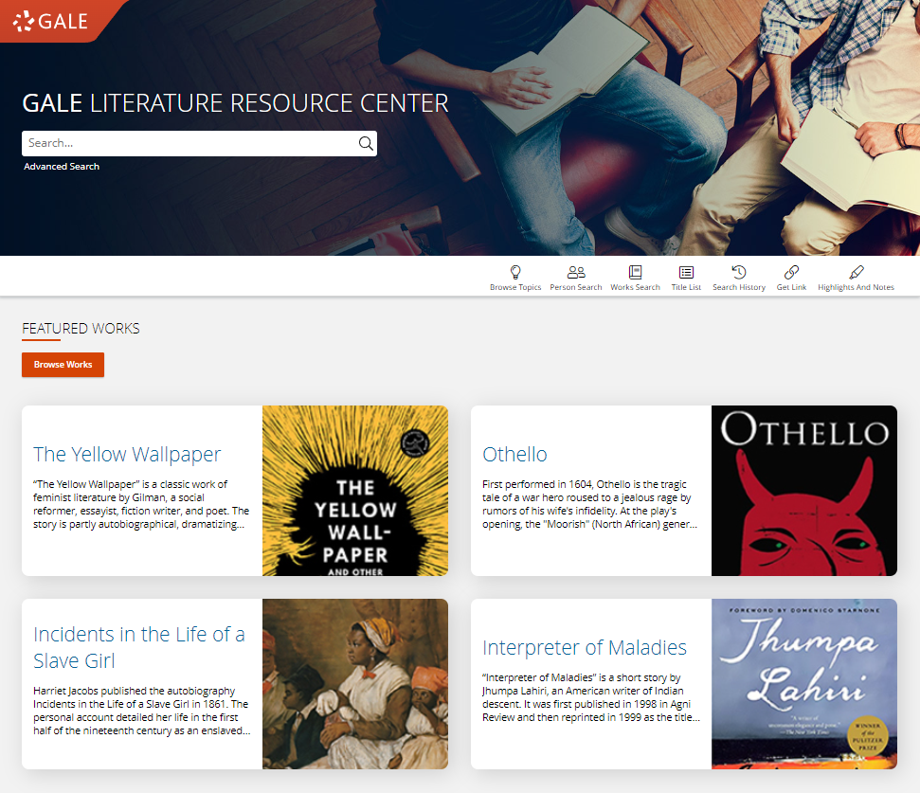
SUPPORT LITERARY RESEARCH
PERSON SEARCH
Search or browse for individuals
Notes:
To utilize the Person Search navigate to the tool bar at the top of the homepage or a search results page. Once launched patrons can either browse or search for individuals that meet their searching criteria.

Slide 27
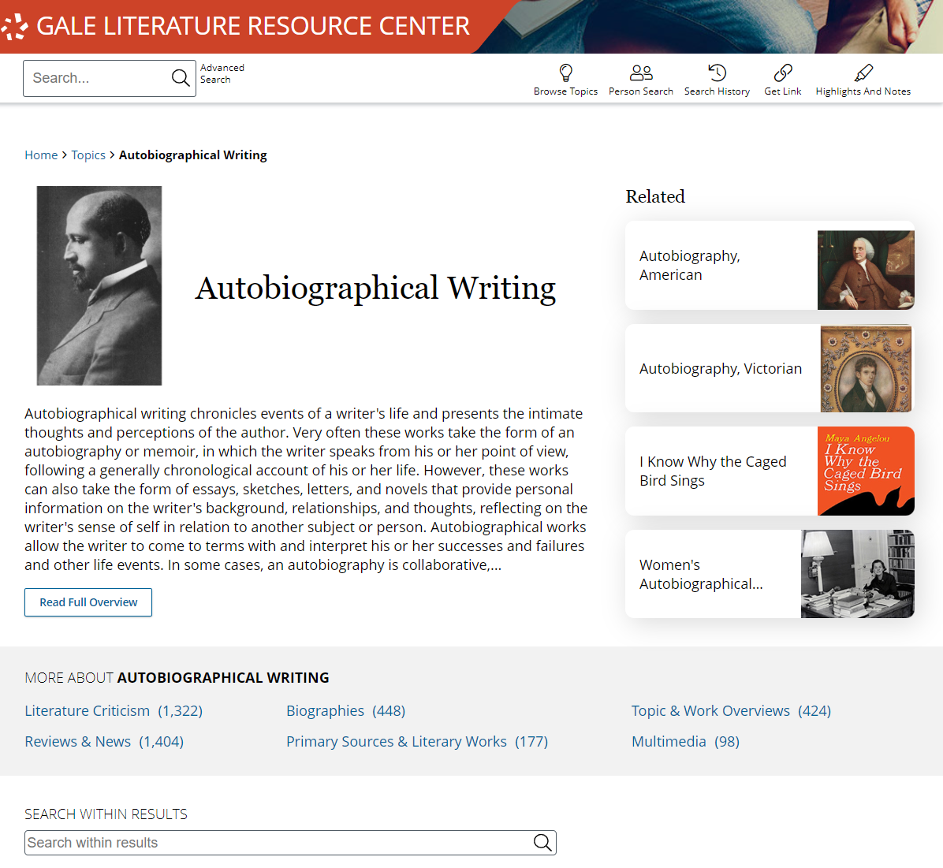
SUPPORT LITERARY RESEARCH
PERSON SEARCH
Search or browse for individuals
TOPIC PAGES
Organized pages that provide a topic overview and list all related results
Notes:
Topic Pages can be found in the bottom sections of the homepage. These pages are helpful for patrons who prefer point and click browsing over searching.

Slide 28
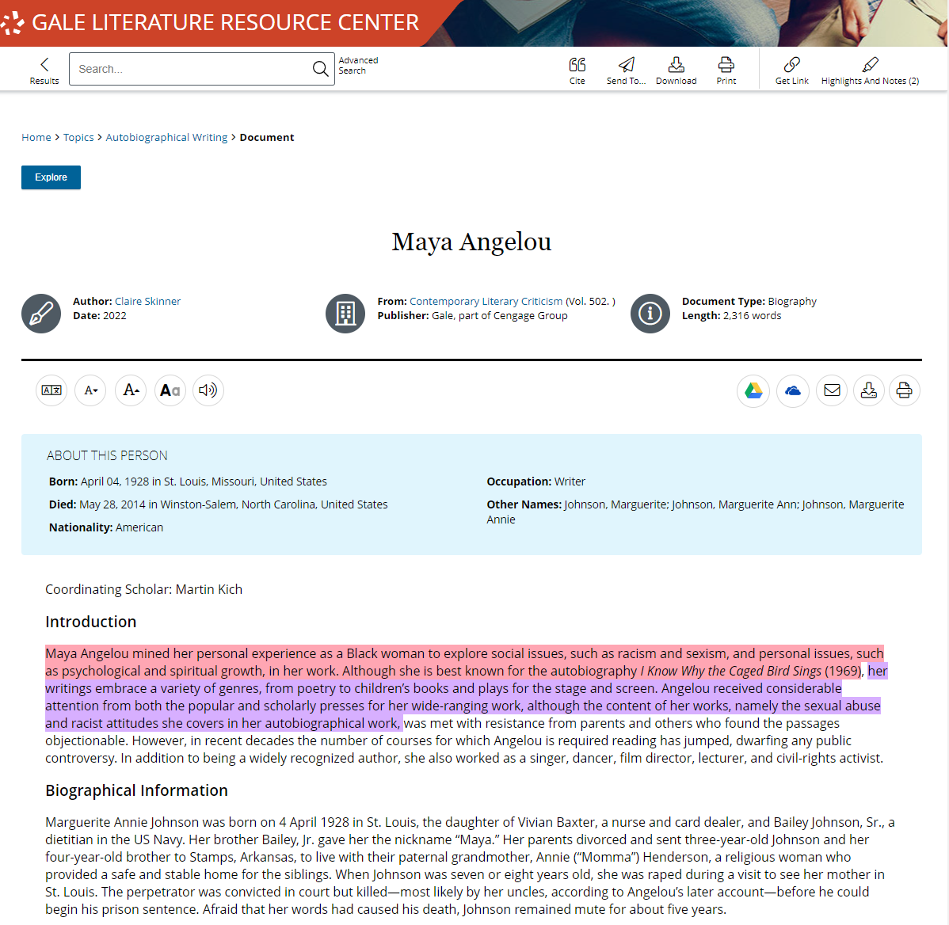
SUPPORT LITERARY RESEARCH
PERSON SEARCH
Search or browse for individuals
TOPIC PAGES
Organized pages that provide a topic overview and list all related results
HIGHLIGHTS AND NOTES
All documents can be highlighted and annotated to support a deeper understanding of topics
Notes:
All text results include the option to add highlights and notes. To get started, select text within the document as you normally would to copy or paste text (click and drag on your computer, or tap the first and last word on mobile devices). You’ll then see a pop-out menu that provides color options and the ability to add notes. Choose the desired color for the highlight and add your thoughts to the notes field.
Be sure to take the highlighted item with you before you close the resource by downloading, printing, or sending the item to Google Drive or Microsoft OneDrive. This will provide a copy of the result including any highlights and notes you made within the document.
Note that you can also access the Highlights and Notes menu option in the upper right-hand corner of the resource to access all the highlights and notes you’ve made within a given session. This allows you to easily jump to articles and edit highlights and notes, or to download, print, or send a full list of all your highlights and notes to Google Drive or Microsoft OneDrive. Again, if you plan to use this tool, be sure to download, print, or Send to… before exiting the resource.

Slide 29
?
…
Notes:
Use this slide as a visual prompt for final questions and/or discussions

